Slide 1
Fremont County – Green
Feasibility Study
Spring 2012
Research Team: Jacob Tolman, Justin Andersen, Thresia Mouritsen, Joseph Huckbody, John Beck

Slide 2
Tax Incentives
Energy source: Expiration: Benefit:
Utility & Commercial
Large Wind Jan 1, 2013 30% grant refund
Small Wind Jan 1, 2017 30% grant refund
Open-loop Biomass Facility Jan 1, 2014 30% grant refund
Geothermal Jan 1, 2014 30% grant refund
Geothermal Heat Pumps Jan 1, 2017 10% grant refund
Solar Jan 1, 2017 30% grant refund
Residential
Solar, Biomass, Wind, & Jan 1, 2017 Income tax deduction of
Geothermal 40% year one, 20% years 2-4. Limit $5K per year and $20K total.

Slide 3
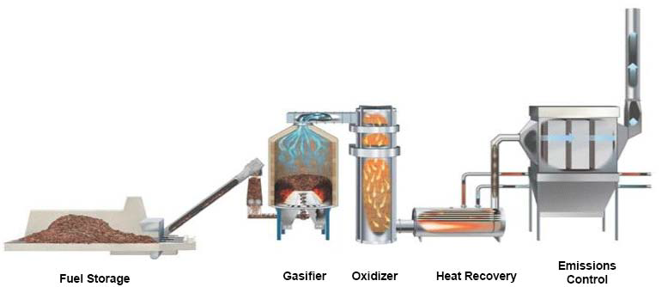
Biomass

Slide 4
Biomass
Boise County biomass case study: 10-13 cents kWh
Biomass cost: $30-45 bdt
Facility cost: 15.4 Million for a 3MW facility
Current biomass available in Fremont County: 8,732 tons at $30 per bdt
1 MW uses 7,500 – 9,000 bdt annually
Viable at $3.32 bdt (without subsidies)
Heavy subsidies

Slide 5
Biomass
Cons
Pollution is high
Turn around is long
Heavy subsidies
Biomass transportation creates a financial burden
Pros
Simple technology
Utilizes waste
Creates jobs
Can be constructed any place close to biomass

Slide 6
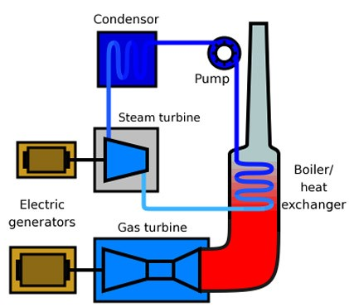
Natural Gas Designs
Simple Cycle
15-42% thermal efficiency
Flexible (Gas engines come in almost all sizes)
Combined Cycle
60% thermal efficiency
More expensive, less flexible
Common Project Design
Phase 1: Simple Cycle
Phase 2: Convert Simple Cycle -> Combined cycle

Slide 7
Natural Gas
Pros
Cheap fuel
Opens doors for other Green energy initiatives (natural gas cars)
Existing infrastructure
High energy production
Cons
Natural gas prices move a lot
Carbon footprint is higher than alternative green energies.
Upfront costs are high
GE turbines are in demand
Water sterilization issues

Slide 8
Wind
Large wind
Energy production up to 2.7 MW per windmill
Wind is free
97-98% operating availability year round
Farmers & ranchers get 3% land rent
Cosmetic concerns
Efficiency at 15%
Large and small land requirements
Wind patterns & geography do not match
Costs are high & tax incentives are set to expire
Source: General Electric Account Manager Dan Fesenmeyer

Slide 9
Wind
Small Wind
Grid-tied systems for net metering
Energy production: from batteries to businesses
Lower investment costs
Near 20% efficiency
Lower cut-in rates – more viable for the area
Tax incentives last longer
Cosmetic concerns erased

Slide 10
Wind
Pros:
Wind is free
Multiple vendors
Residential tax incentives
Cons:
Dependent on wind patterns
Prices are high
Aesthetics

Slide 11
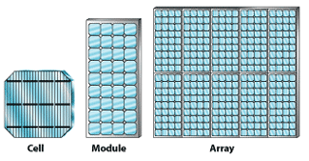
Solar
Two types: PV and CSP
Minimal real estate requirements
Lowest cost of energies researched
Payback period: 3-5 years
Tax benefits till 2017
Efficiencies range from 5% to 42%
(http://www.eere.energy.gov/basics/renewable_energy/pv_systems.html)

Slide 12
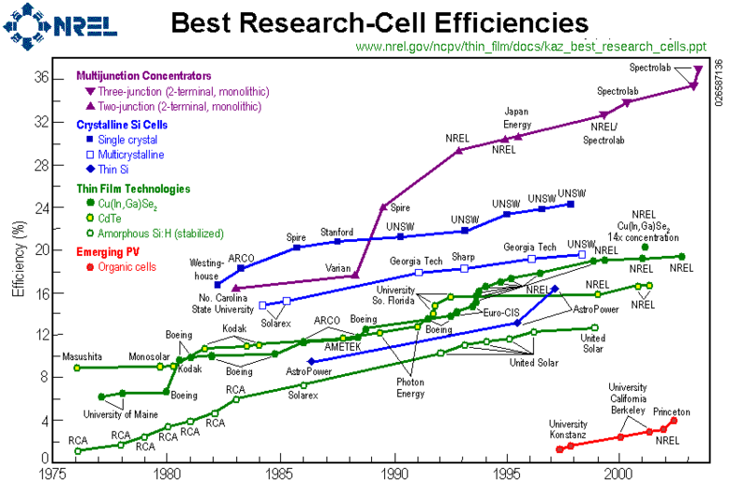
Solar

Slide 13
Solar
Pros:
Sunlight is free
Tax incentive period
Low cost
Short payback period
Low maintenance
Cons:
Cold climate
Low average efficiency
Zero permanent job creation

Slide 14
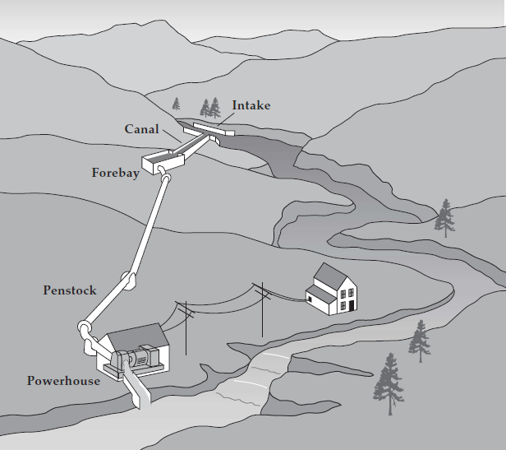
Micro Hydro
197 potential locations
Initial investment cost: $10,000 - $30,000
Payback period: 5 – 24 years
Yearly maintenance cost 1.5% - 2.5%
No ecological impact
State-level permits
Energy prices: 5.1 – 11.3 cents per kWh

Slide 15
Micro Hydro
Pros
Many possible locations
Inexpensive installation
Low maintenance costs
Steady flow of natural resource
Environmentally friendly
Cons
Low power output
Rural location of sites
Little job creation

Slide 16
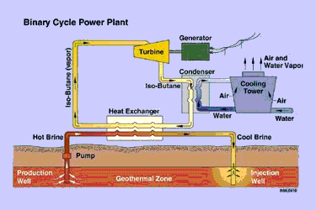
Geothermal
Newdale, Fremont County, Idaho
Temperatures point to a binary cycle system
Costs per kWh: 6 to 8 cents per kWh
Tax incentive for plants placed in service by December 31, 2013: amount of 2.2¢/kWh.
Total investment approximately $13 million to build 3 to 5 production wells in the Newdale location. The Department of Energy estimates costs around $2500 per installed kW.

Slide 17
Geothermal
Virtually no pollutants, low steam point liquid, & zero emissions
Availability & efficiency
Versatility: homes and/or businesses
Job creation: about 1.7 permanent jobs per megawatt (MW) of capacity installed.
Side effects: greenhouses, mineral revenue, long-term energy supply and job creation
Up front costs
Payback: 10-20 years

Slide 18
Geothermal
Pros
Geothermal resources are available in the area for energy production.
Job creation
There are multiple available uses for the resource (greenhouse/direct application for heating homes and businesses)
Low, dependable cost of energy
Zero emissions from Binary power plant
Cons
High upfront costs
There are some documented effects of opening an underground reservoir (micro quakes, ground sinkage)
Long payback period
Much of the known Newdale area land with geothermal capabilities is privately owned.

Slide 19
Recommendations
Residential solar & small wind are ready for on-grid installation.
Geothermal requires additional testing to pinpoint temperature and location, but is
cheap and viable.
Micro hydro depends on remoteness from grid connection. Individual sites need assessment.
Natural gas can threaten the environment, but energy production is the highest.
Big wind does not have required geography and wind patterns.
Biomass requires heavy subsidies. Long-term fuel source is unreliable.

